Slide 1
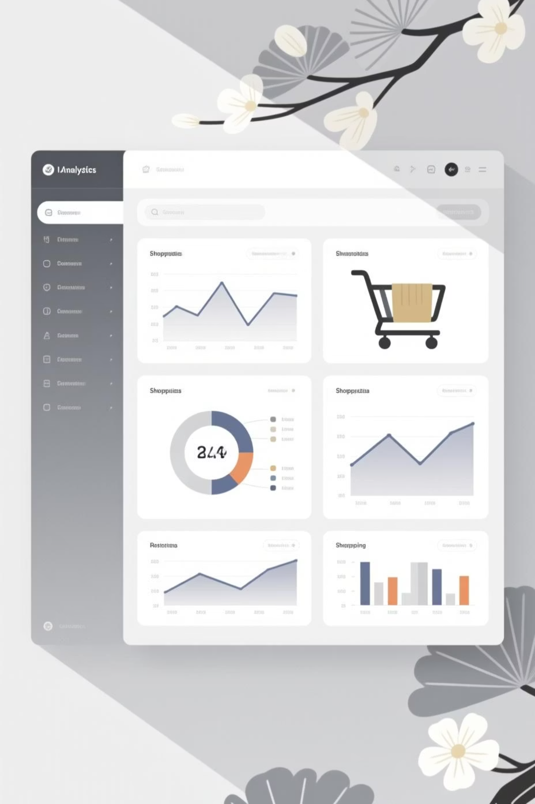
Customer Shopping Behavior Analysis
Analyzing 3,900 purchases to uncover insights into spending patterns, customer segments, and product preferences that drive strategic business decisions.

Slide 2
Dataset Overview
3,900
18
50
25
Total Purchases
Data Columns
Locations
Product Types
Transactions analyzed across all categories
Features covering demographics and behavior
Geographic distribution of customers
Items across four major categories
Key features include customer demographics, purchase details, shopping behavior metrics, and review ratings with minimal missing data.

Slide 3

Data Preparation & Engineering
Python Analysis Pipeline
Loaded dataset using pandas for exploration
Imputed missing Review Ratings using category medians
Standardized columns to snake_case format
Created age_group bins for segmentation
Integrated cleaned data into PostgreSQL

Slide 4

Revenue Analysis by Gender
Male Customers
Female Customers
$157,890 total revenue
$75,191 total revenue
Representing 68% of total sales with 2,652 customers
Representing 32% of total sales with 1,248 customers

Slide 5
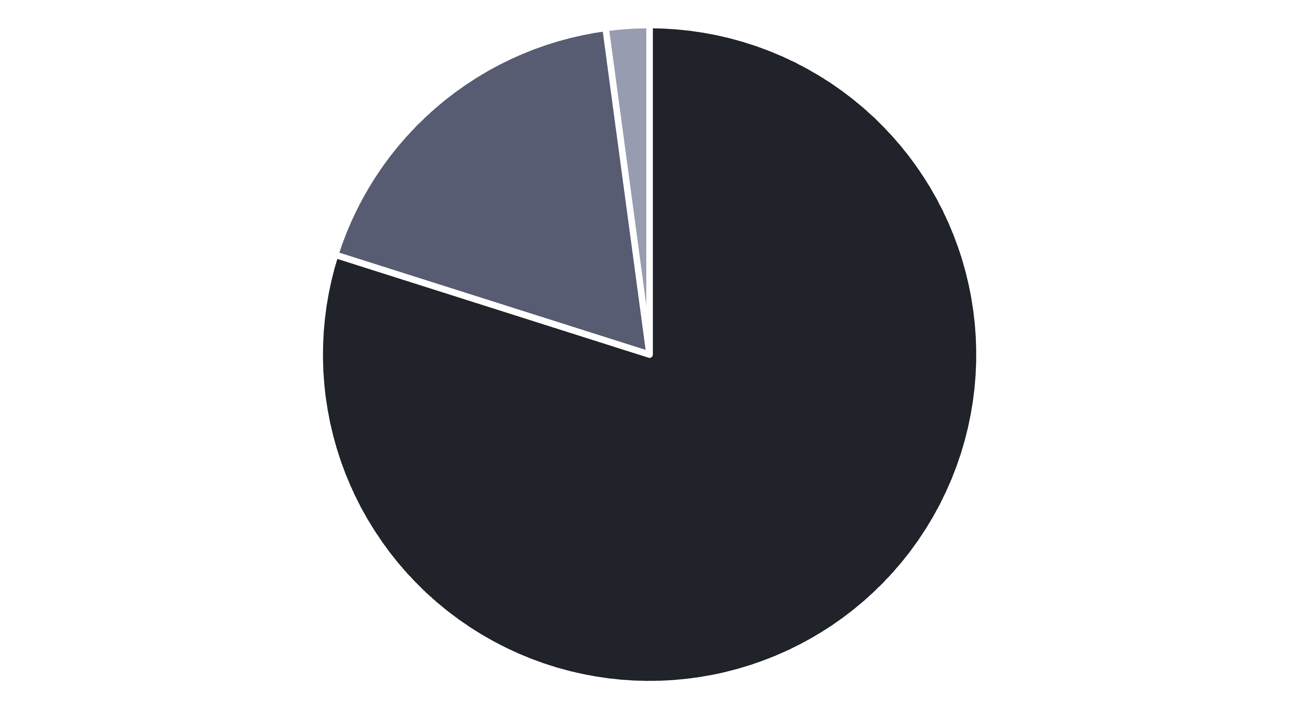
Customer Segmentation Insights
Loyal
Returning
New
Loyal customers dominate at 80% of the base, while new customer acquisition remains low at just 2%. Focus on converting returning customers to loyal status.

Slide 6

Top-Rated Products
1
2
3
Gloves
Sandals
Boots
Average rating: 3.86
Average rating: 3.84
Average rating: 3.82
4
5
Hat
Skirt
Average rating: 3.80
Average rating: 3.78

Slide 7
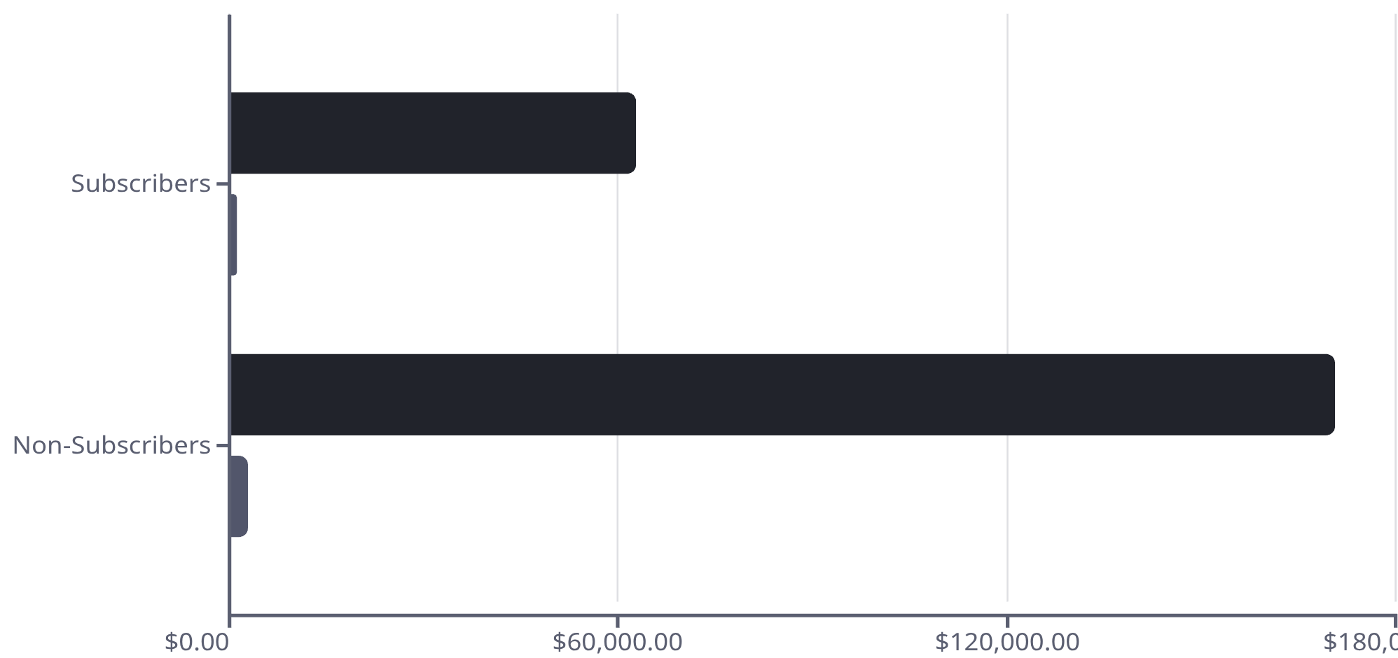
Subscription vs. Non-Subscription Performance
Non-subscribers generate 73% of revenue despite similar average spend ($59.87 vs $59.49).
Opportunity: Converting just 10% of non-subscribers could add $17K in revenue.
Total Revenue
Customers

Slide 8
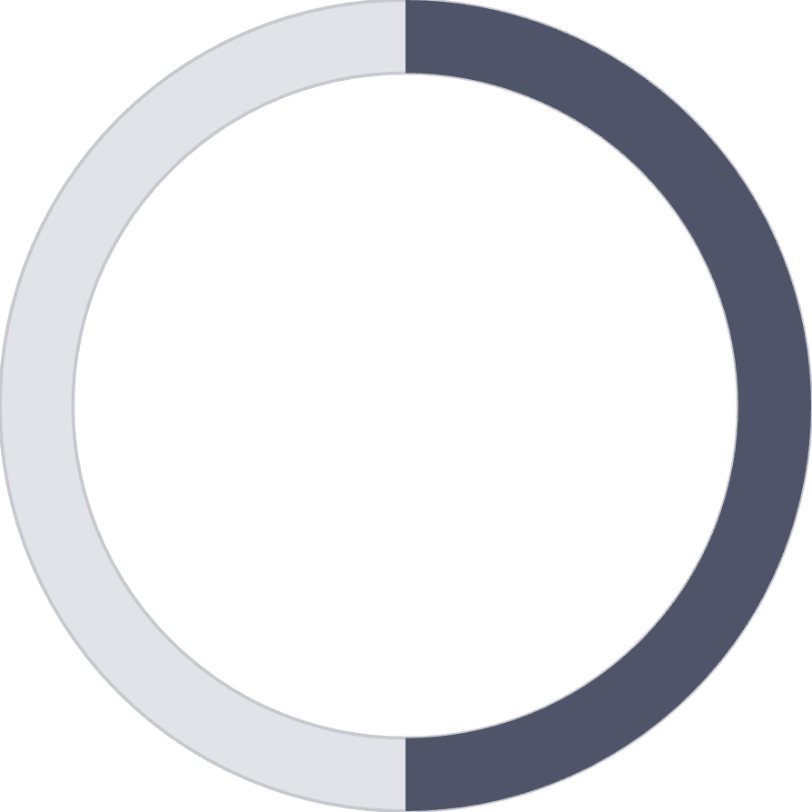
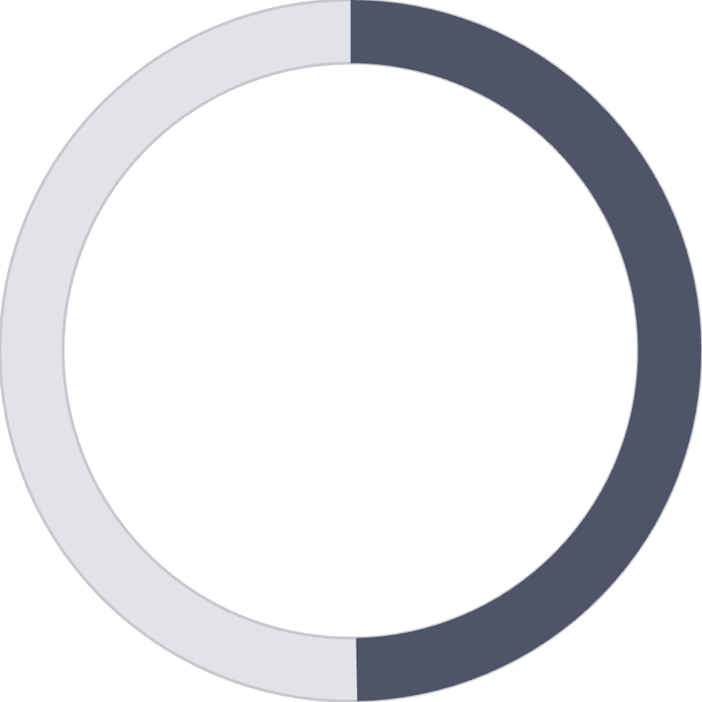
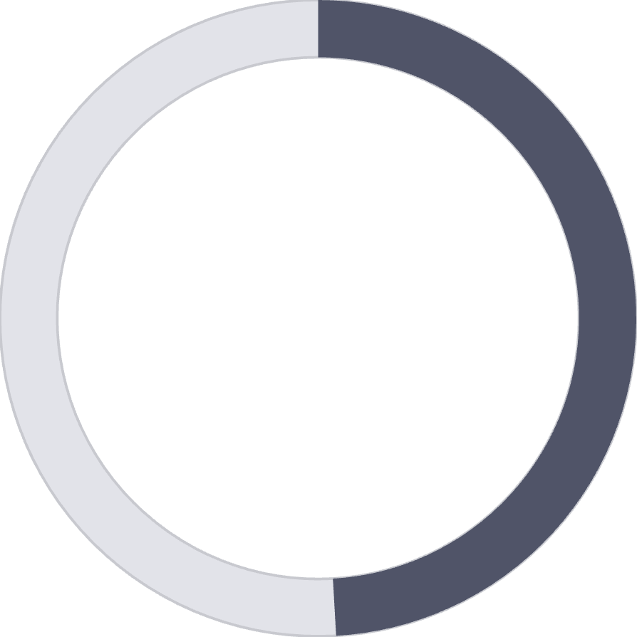
Discount Strategy Analysis
50%
49.7%
49.1%
Hats
Sneakers
Coats
Highest discount rate
Second highest discount rate
Third highest discount rate
839 customers used discounts but still spent above average ($60), indicating discounts drive volume without sacrificing high-value purchases.

Slide 9
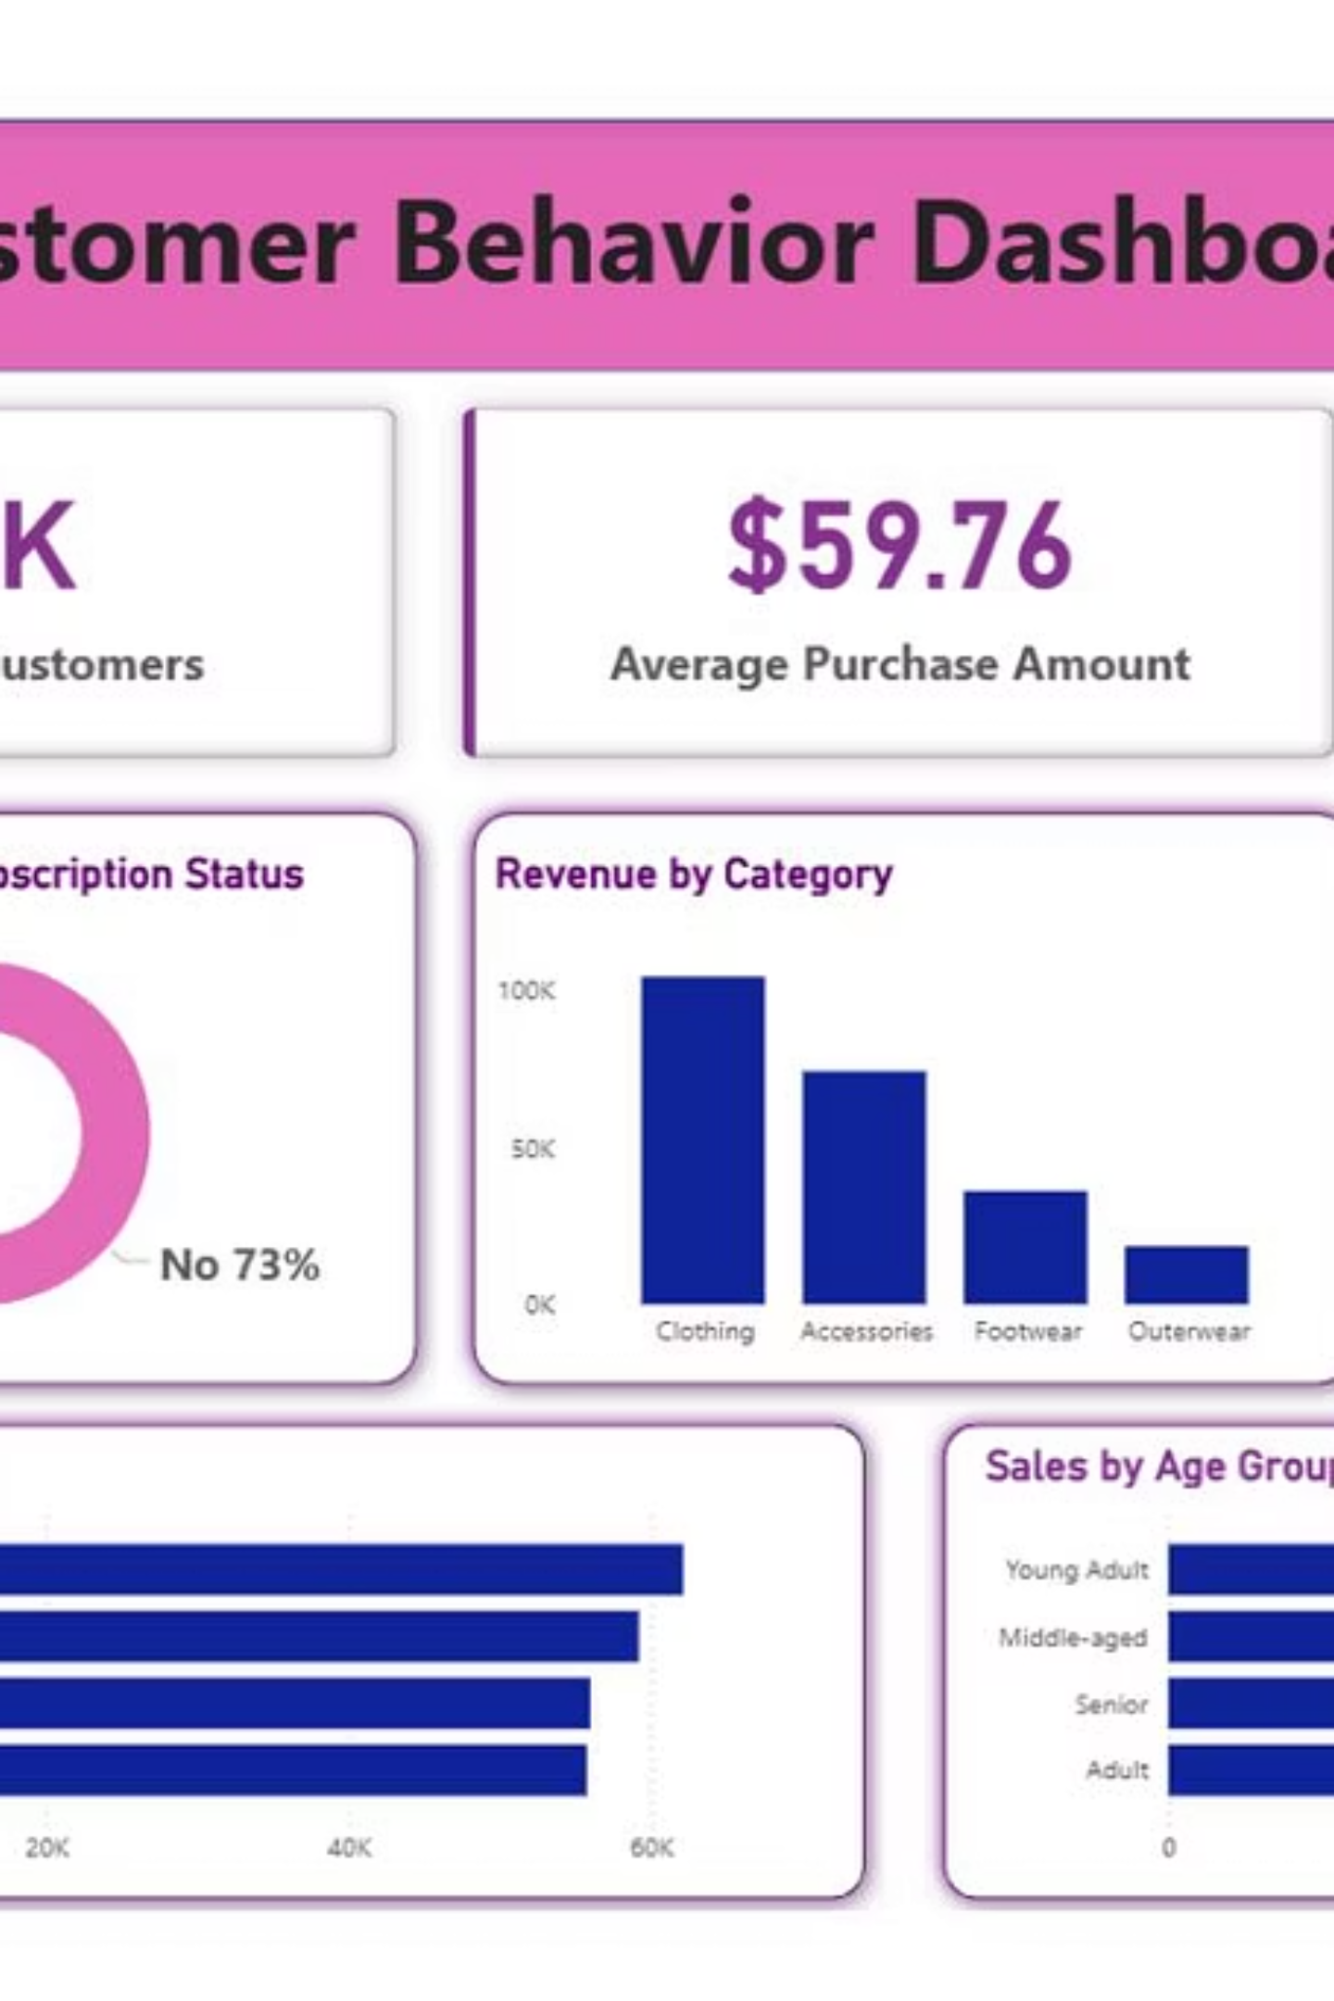
Power BI Dashboard
Interactive visualization presenting key metrics including revenue trends, customer segmentation, product performance, and behavioral patterns across all dimensions.

Slide 10






Strategic Recommendations
Boost Subscriptions
Loyalty Programs
Targeted Marketing
Promote exclusive benefits to convert non-subscribers and increase recurring revenue.
Reward repeat buyers to accelerate movement into the loyal customer segment.
Focus campaigns on high-revenue age groups and express-shipping users for maximum ROI.
Product Positioning
Discount Optimization
Highlight top-rated items like Gloves and Sandals in promotional campaigns.
Balance promotional sales boosts with margin control to protect profitability.

